Slide 1

Build your first QML Interface

Slide 2
Introduction
Declarative language
Inline Javascript to handle imperative aspects
Component Based Architecture
Property Bindings
Cross Platform Compatibility
Adaptive UI for any screen size

Slide 3




Some Popular Qt/QML applications

Slide 4
Demo - Requirements

Slide 5
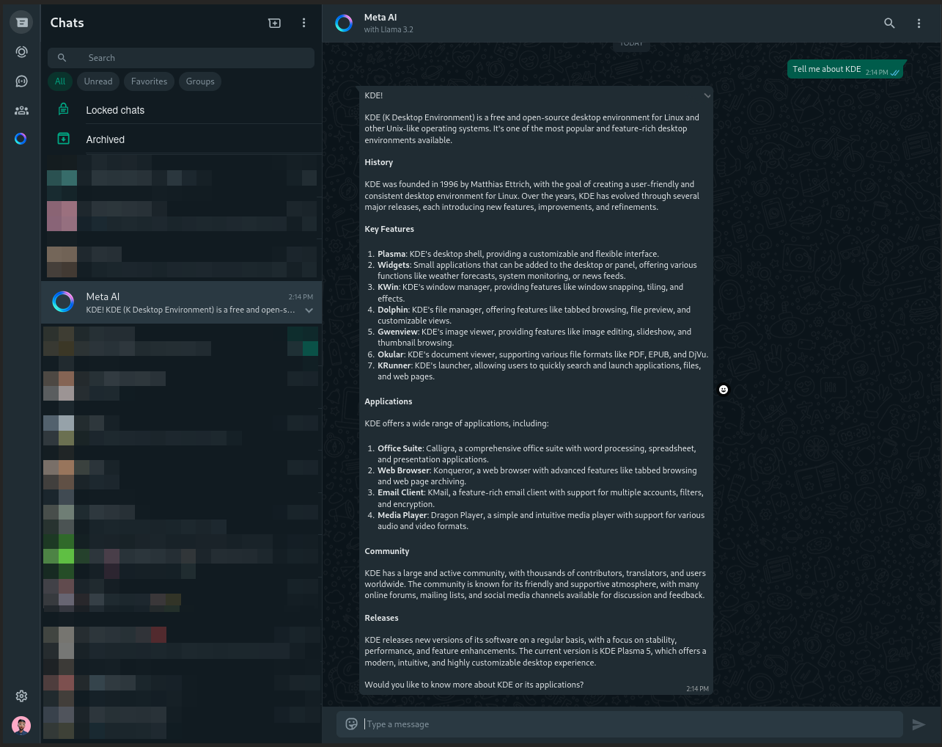
Whatsapp UI (Referrence)

Slide 6

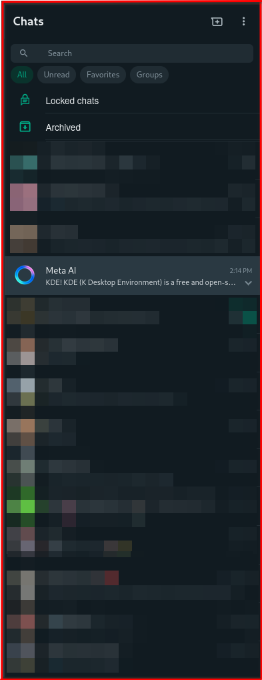
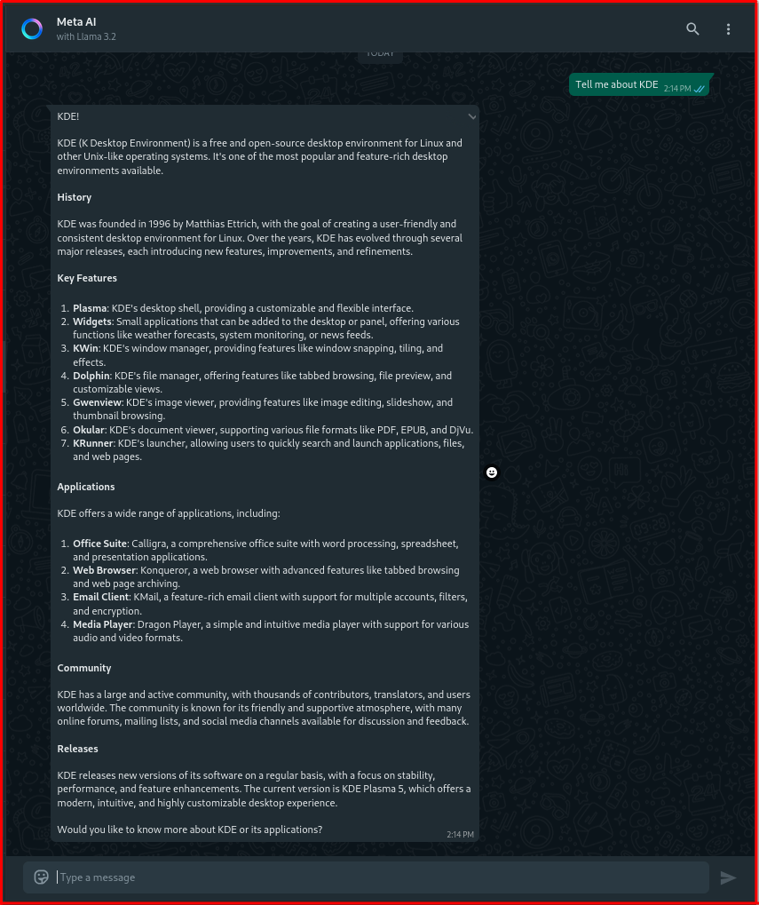

Slide 7
Sidebar
Rectangle {
id: sidebar
color: "#202c33"
implicitWidth: 60
implicitHeight: 800
ColumnLayout {
anchors.fill: parent
Button {
Layout.alignment: Qt.AlignCenter
Layout.preferredHeight: 40
Layout.preferredWidth: 40
icon {
source: "../images/chats.png"
}
}
}

Slide 8

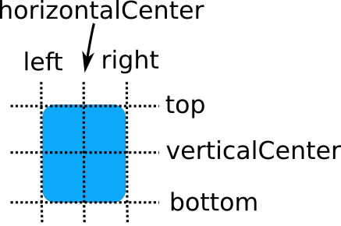
Positioning elements inside QML
Layouts
ColumnLayout
B. RowLayout
Anchors

Slide 9
ConversationList
ListView {
id: conversationList
ListModel {
id: conversationListModel
ListElement {
name: "John Nolan"
time: ""
chat: "I want to be a TO!"
}
...
}
model: conversationListModel
delegate: Rectangle {
...
}
}

